Slide 1

Meetup @Swiss Life
GraphQL in a Microservice Architecture

Slide 2
Agenda
18:30 | Introduction | Philippe
18:35 | Data Fetching Challenges | Stefan
18:45 | GraphQL with HotChocolate | Michael
19:15 | Break
19:30 | Microservice Architecture and GraphQL | Gabriel
19:40 | GraphQL Schema Stitching | Michael
20:10 | Q & A
20:15 | Apéro

Slide 3
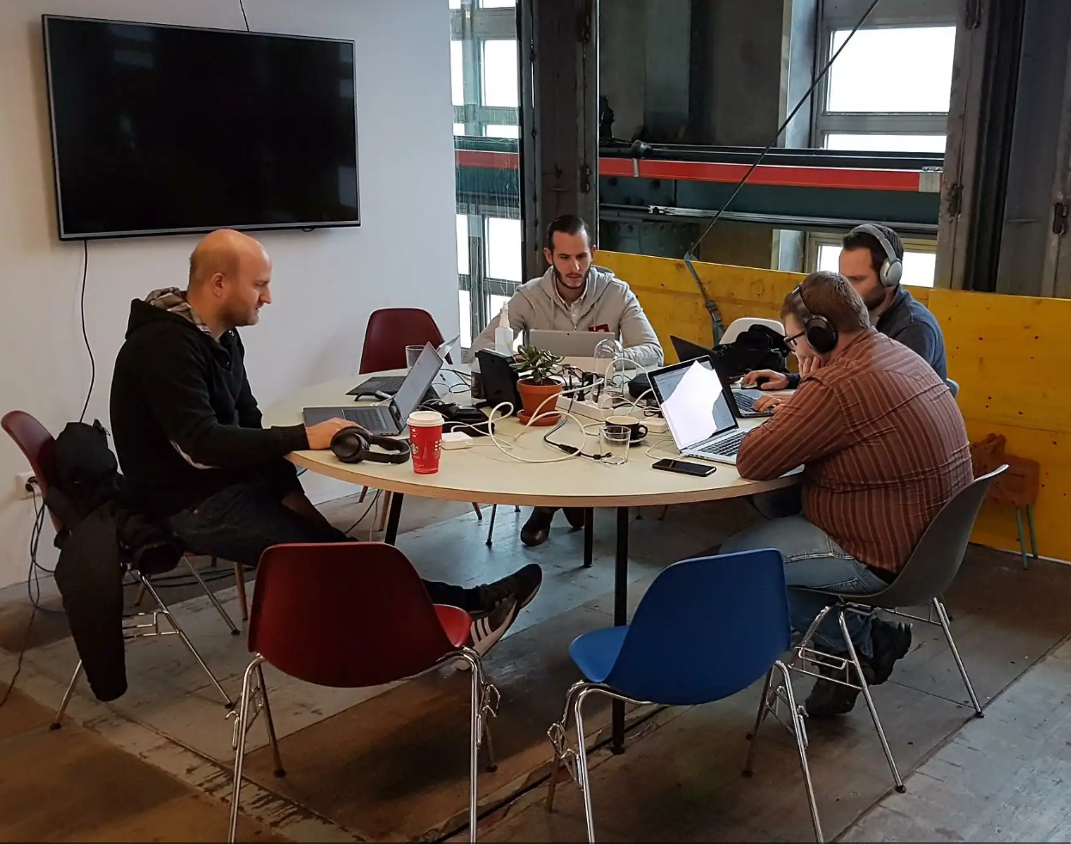
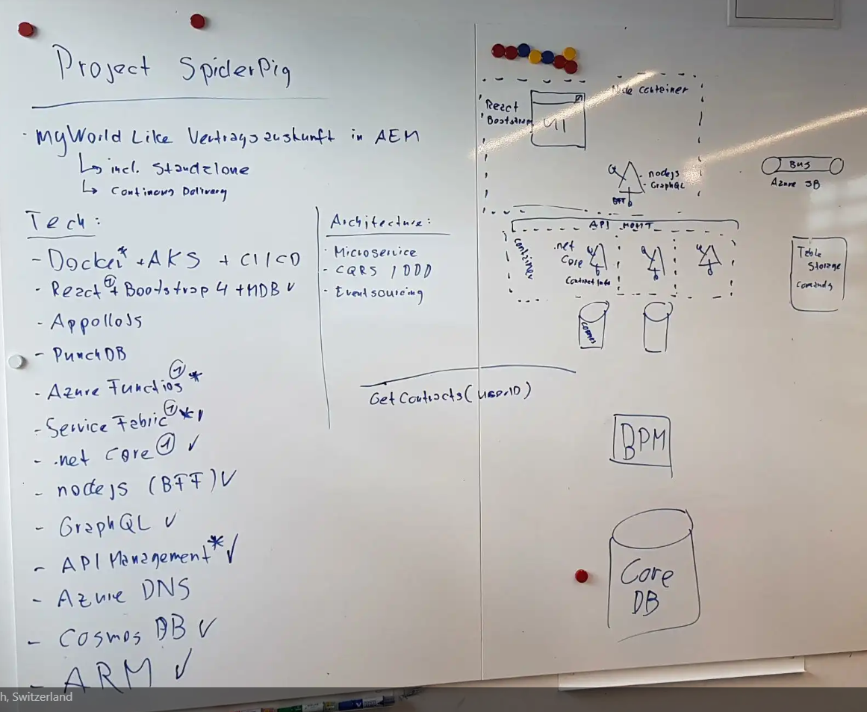

Why we are here today?
@Kraftwerk Selnau, 1.12.2017

Slide 4
Data Fetching Challenges

Slide 5

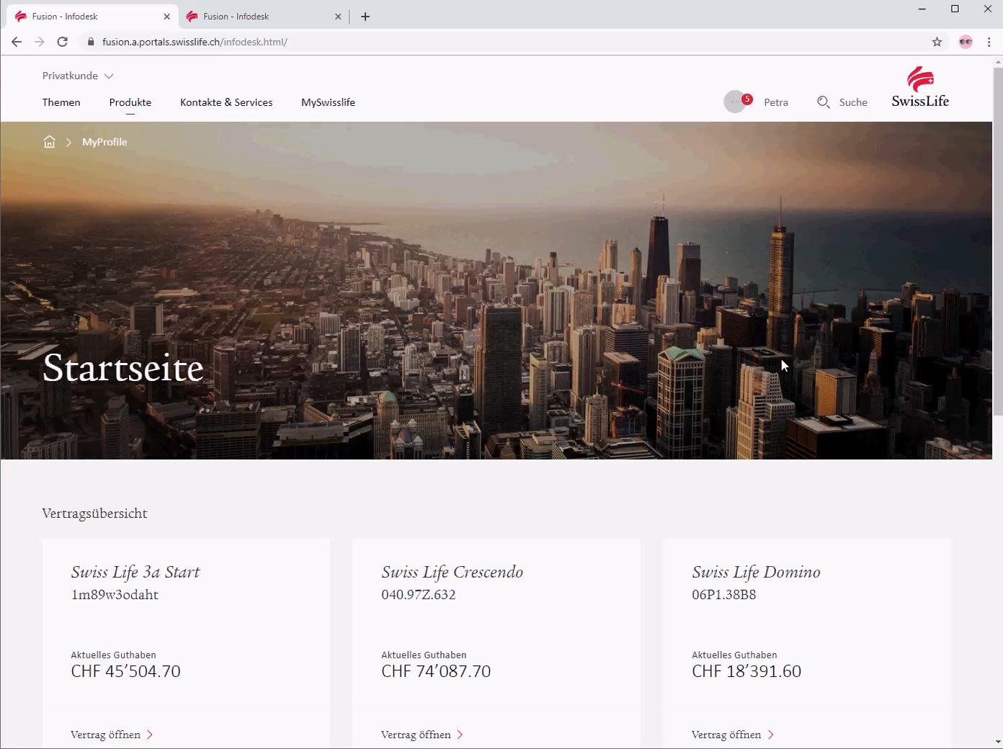
New Swiss Life Customer Portal (WIP)
Notes:
00078f09-80c7-26a6-ca85-030b61ff1892
00043835-e342-496f-a03c-4026ee28672d

Slide 6
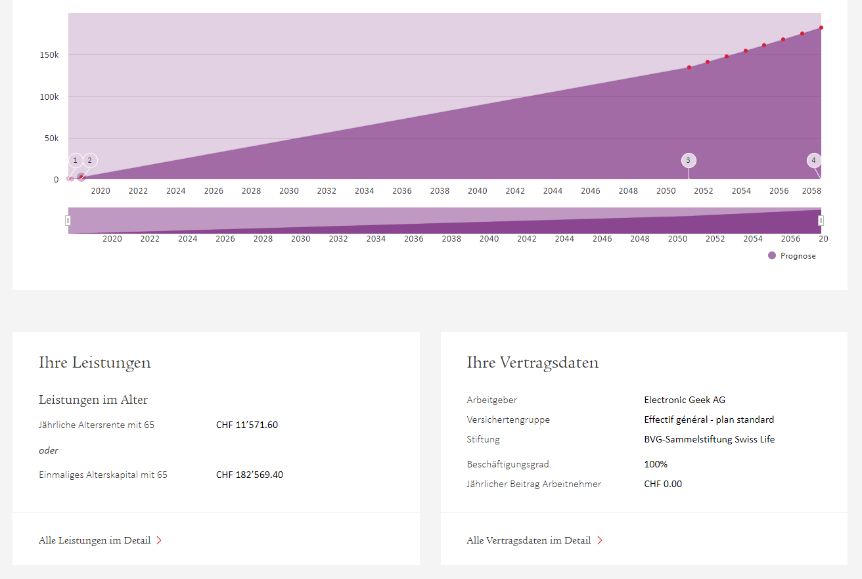
Contract Page
A page in the customer portal
Consists of multiple components
Each having their own data needs

Slide 7

Data Requirements
chart {
contractId
productName
dataPoints
}
Chart
benefits {
contractId
yearlyPension
pensionCapital
}
Benefits
Summary
summary {
contractId
productName
stakeholder
insuranceType
}

Slide 8

Multiple Requests
contractId
Chart
{
dataPoints
}
Charting REST Endpoint
{
contractId
productName
dataPoints
}
customerId
Benefits
{
contractId
productName
}
Summary
Contract REST Endpoint

Slide 9
What if we could fetch all in just a single request?

Slide 10
Overfetching: Fetching more data then you actually need
Chart
Benefits
id
{
contractId
begin
end
number
salary
yearlyPension
pensionCapital
[…]
}
Contract REST Endpoint
Summary

Slide 11
What if we could get just the data that we need?

Slide 12

Wish List
{
contractId
productName
dataPoints
yearlyPension
pensionCapital
stakeholder
insuranceType
}
Chart
Benefits
{
contractId: ‘123'
productName: ‘Foo Insurance’
dataPoints: […]
yearlyPension: 99999
pensionCapital : 99999
stakeholder: ‘Bar Company’
insuranceType: ‘Cheap’
}
Magic Endpoint
Summary

Slide 13
What if we just get what we need in just one call?

Slide 14
GraphQL on .NET

Slide 15


Slide 16
Demo

Slide 17



Slide 18
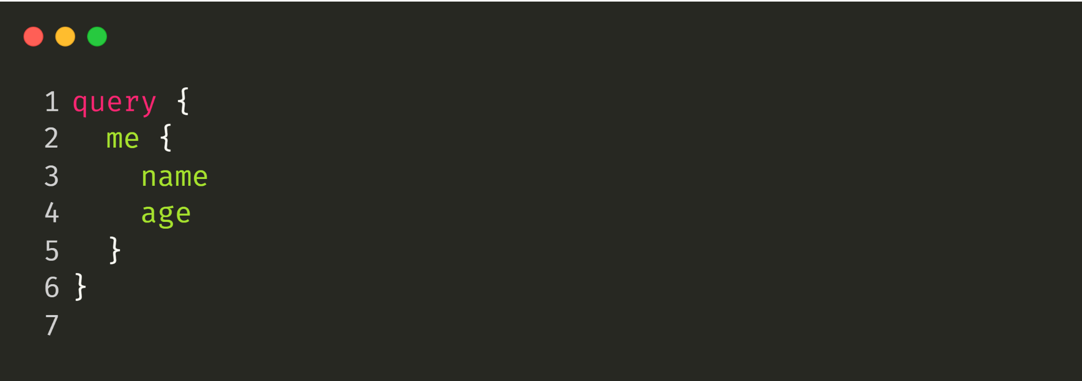
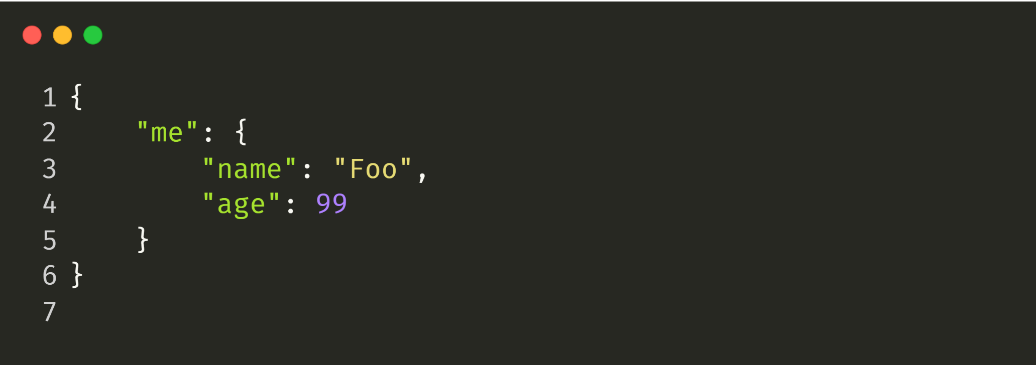

Slide 19
GET https://webservices.amazon.com/onca/xml?
Service=AWSECommerceService&
AWSAccessKeyId=mY-Sup3r-s3cr3!-k3y&
AssociateTag=12345&
Operation=ItemLookup&
ItemId=0316067938&
ResponseGroup=Reviews&
TruncateReviewsAt=256&
IncludeReviewsSummary=False&
Version=2013-08-01&
Timestamp=[YYYY-MM-DDThh:mm:ssZ]&
Signature=[Request Signature]

Slide 22
What is GraphQL?

Slide 23
GraphQL
One Endpoint
No over- or under-fetching
Simplicity
Real-time
Predictability
No versioning
One Request
Type System
Documentation

Slide 24
Demo

Slide 25
What GraphQL is not
Graph database query language
Solution for binary streams
Facebooks version of OData
Bound to a specific data source
Limited to HTTP
Limited to the JavaScript world
A good solution for a health check endpoint.

Slide 26
Write | Mutation | PUT, POST, PATCH DELETE
Read | Query | GET
 |  | PUT, POST, PATCH DELETE
Events | Subscriptions | N/A
Operation | GraphQL | REST

Slide 27
Demo

Slide 28
N+1, Filters Paging

Slide 29
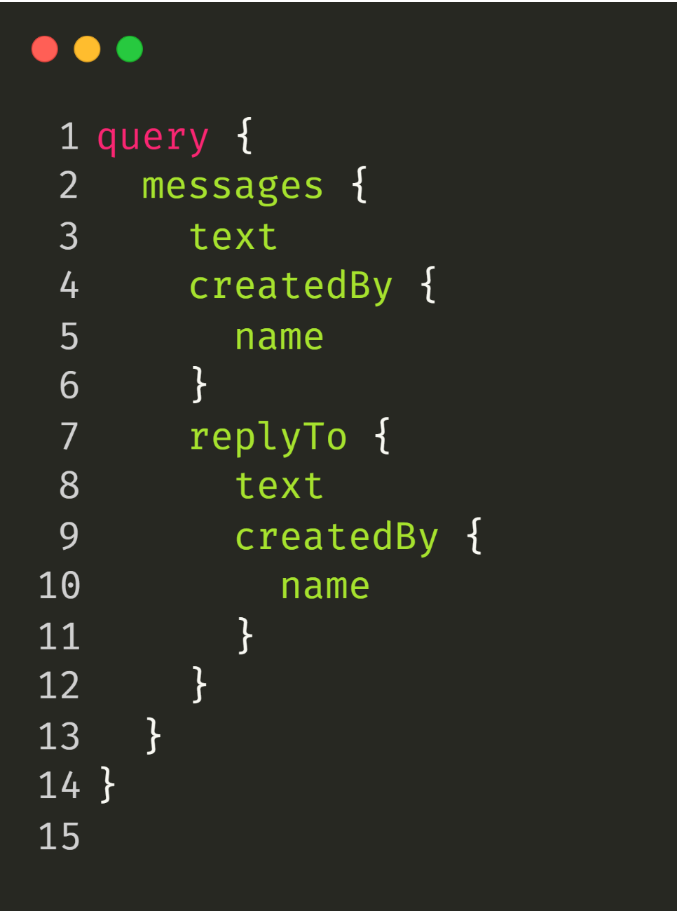

Slide 30


Slide 31
DB
Resolver
Resolver
Resolver
Resolver
DataLoader
Resolver
Resolver
Cache
Resolver
Resolver
Resolver
Resolver
Resolver

Slide 32
Demo

Slide 33
Break

Slide 34
GraphQL & Microservices

Slide 35

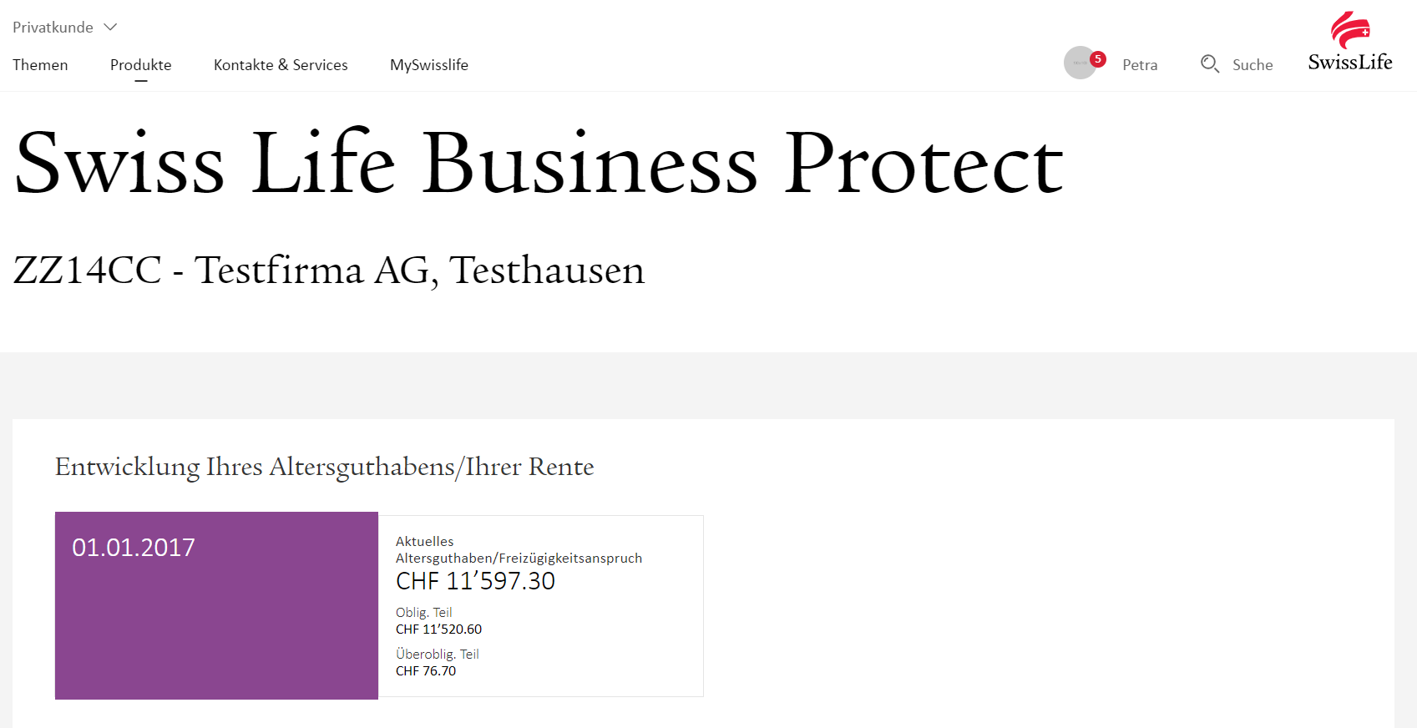
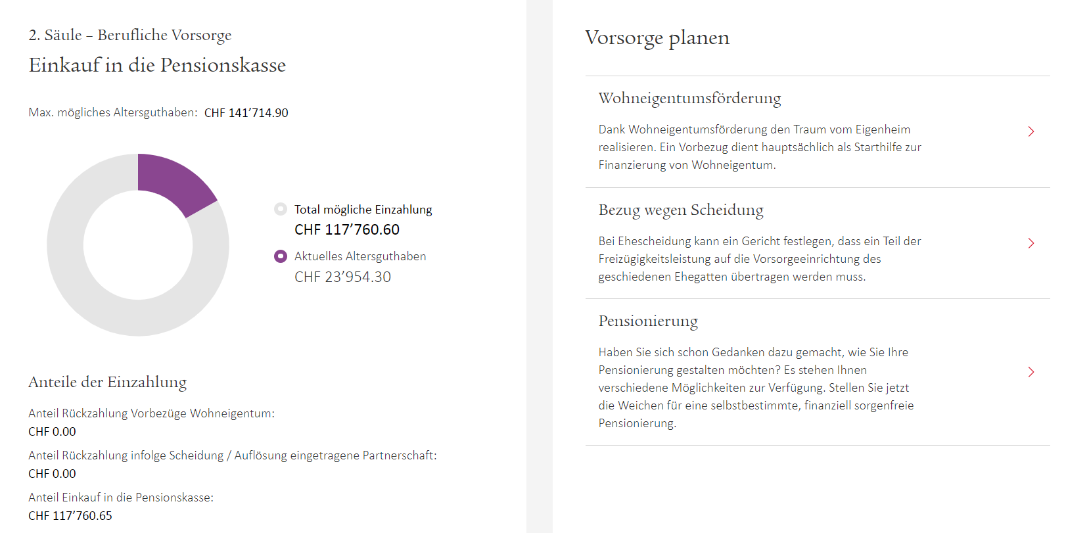


Stitching
Profile
Contract
Document
Advisor
User

Slide 36
What is schema stitching?

Slide 37
The capability to merge multiple GraphQL schemas into one schema.

Slide 38

One GraphQL Query
query {
me {
messages {
# Hot Chocolate GraphQL
text
# Apollo Server
createdBy {
name
}
# Abritray REST Endpoint
views
likes
replies
}
}
}
Hot Chocolate Gateway
text
createdBy
views, likes, replies
{REST}
Apollo GraphQL
Hot Chocolate GraphQL
Arbitrary REST Endpoint
Raven DB
Mongo DB
SQL Server

Slide 39
Demo

Slide 40
Testing Your Schema

Slide 41
Demo

Slide 42
Outlook

Slide 43
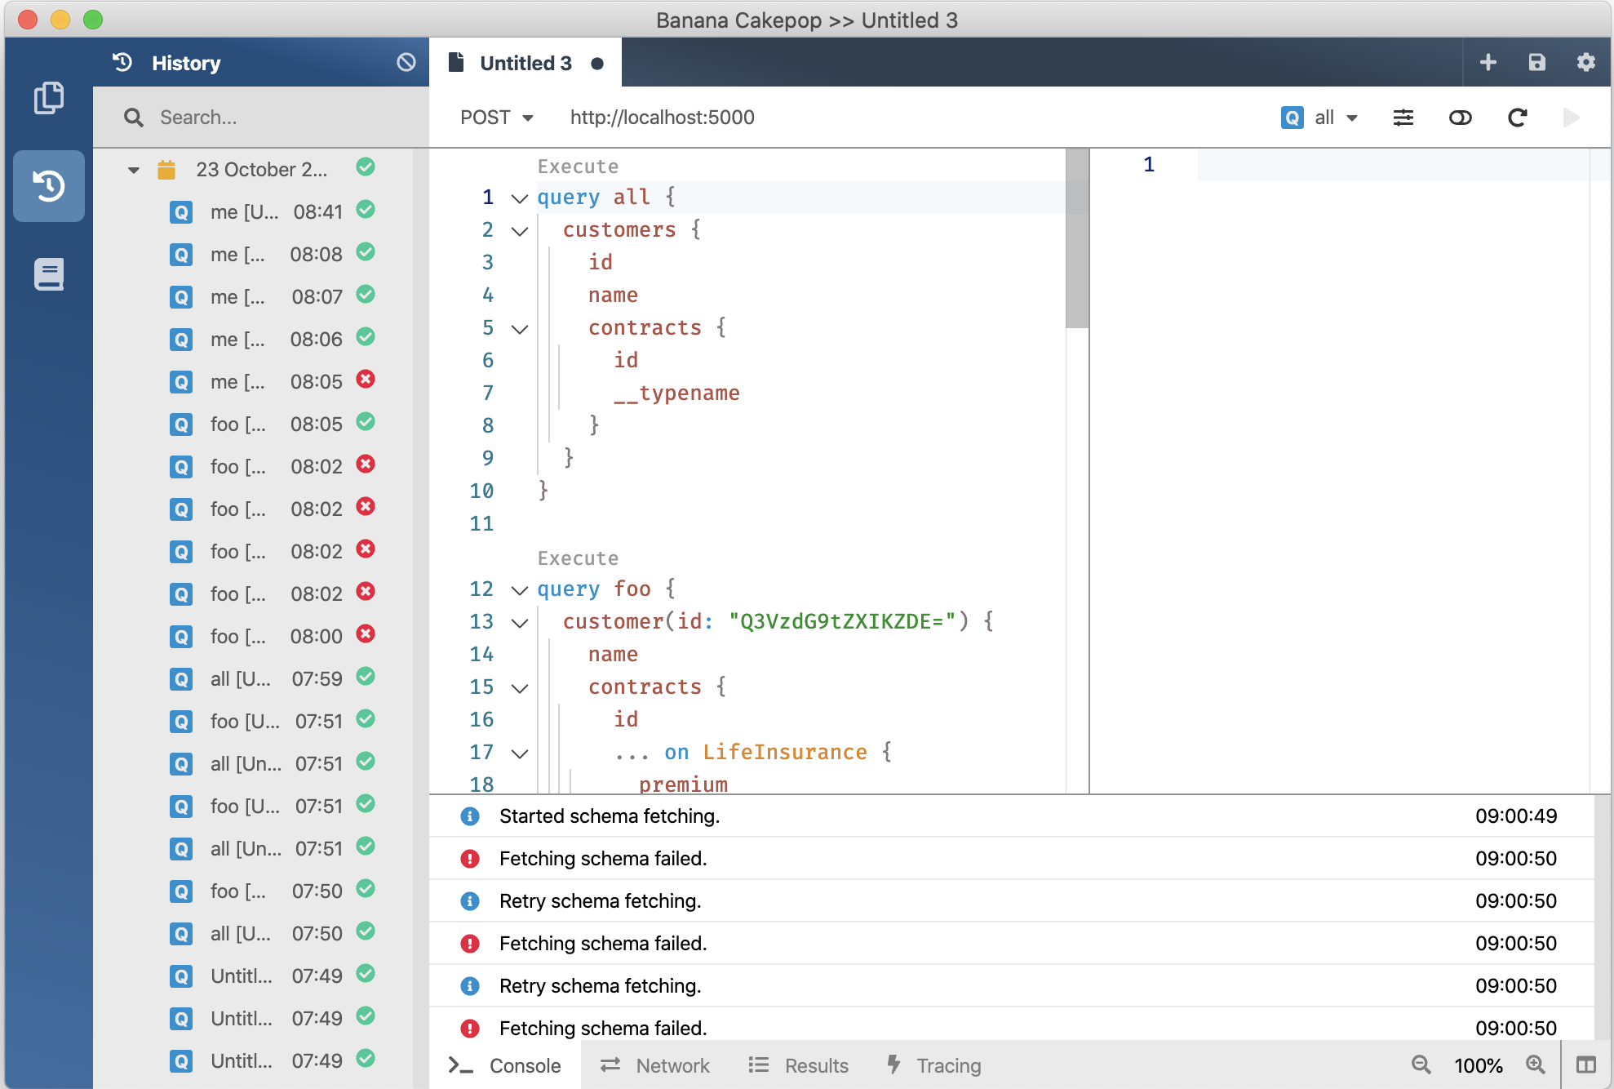
V10
GraphQL Gateway
V11 January 2020
V12 August 2020
GraphQL Client
GraphQL Server
Developer Tooling
Supports Blazor and Xamarin
Execution Plans @defer @stream
Schema Registry (Schema Change Tracking, CI Tools)
Automatic Database Mapping
GraphQL Analytics
Operations Manager (Execution Plan Store, Whitelisting, Client Registry)

Slide 44
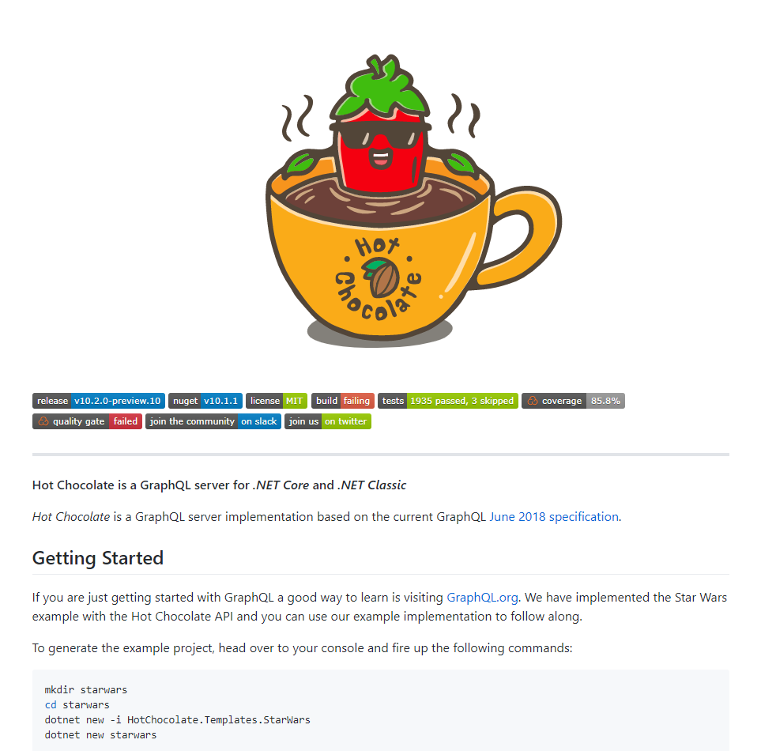
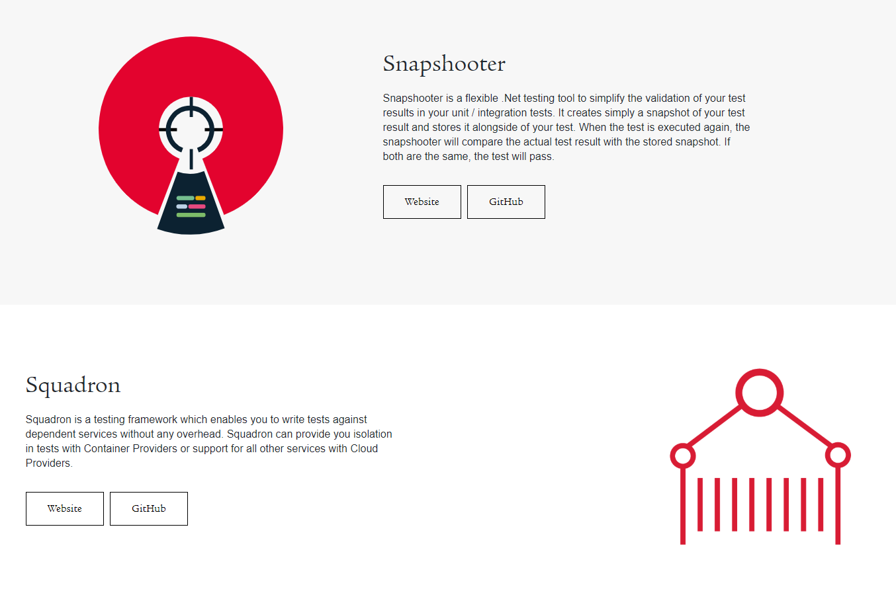
Open Source

Slide 45
Q & A

Slide 46






https://github.com/chillicream
https://swisslife-oss.github.io
https://hotchocolate.io
opensource@swisslife.ch
@chilli_cream
@swisslife_oss
https://hotchocolategraphql.slack.com
https://swisslife-oss.slack.com

Slide 47
Apéro

Slide 48
https://github.com/chillicream
https://swisslife-oss.github.io
https://hotchocolate.io
opensource@swisslife.ch
@chilli_cream
@swisslife_oss
https://hotchocolategraphql.slack.com
https://swisslife-oss.slack.com

